Slide 1
Intelligent and not so intelligent computing
Know your limits, some service and things to think about in the data deluge!
Richard Conway, richard@elastacloud.com

Slide 2


Slide 3
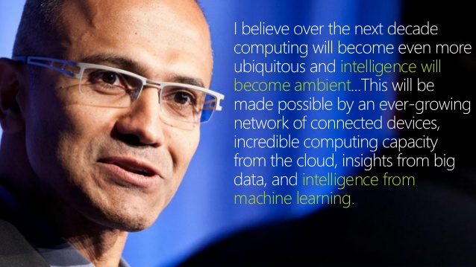

Slide 4
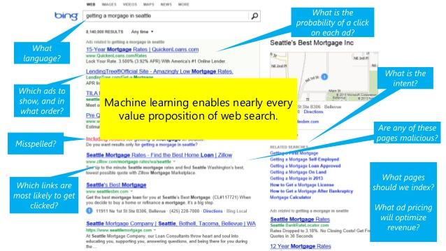

Slide 5
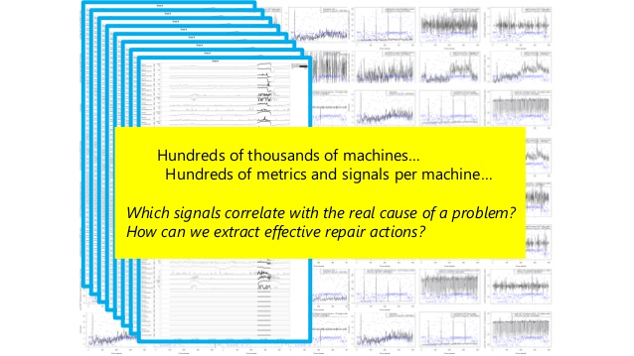

Slide 6
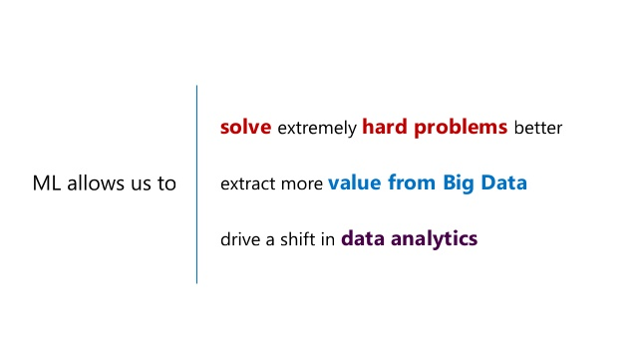

Slide 7
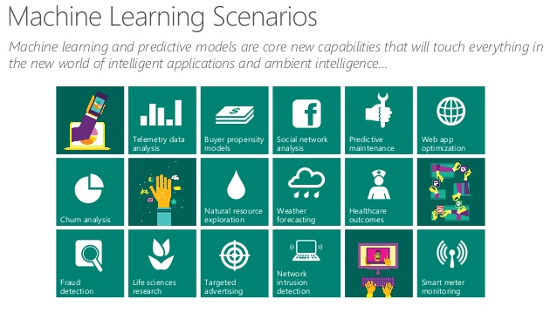

Slide 8


Slide 9
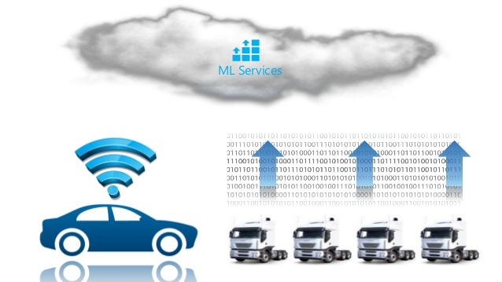

Slide 10
Your arsenal in Azure
Some things to think about

Slide 11
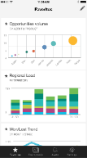
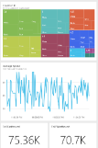
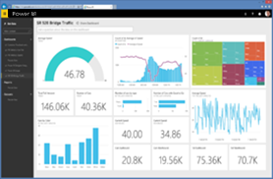
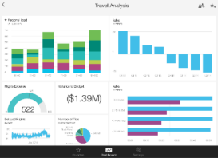
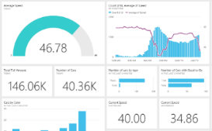

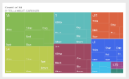


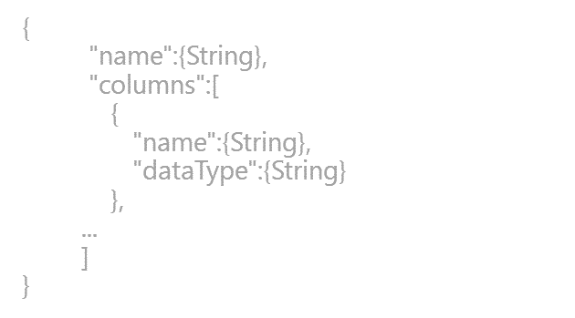
PowerBI
SaaS solutions
E.g. Marketo, Salesforce, GitHub, Google analytics
Content packs
Natural language query
Sharing & collaboration
On-premises data
E.g. Analysis Services
Live dashboards
Organizational content packs Corporate data sources, or external data services
Visualizations
Azure services
E.g. Azure SQL, Stream Analytics
Excel files
Workbook data and data models
Reports
01001
10101
Power BI Desktop files
Related data from files, databases, Azure, and other sources
Datasets
0110001
00010110
Data refresh
Power BI Desktop
Power BI REST API
Prepare
Explore
Report
Share
Notes:
Let’s walk through an overview of how Power BI works.
1. The Power BI service, sometimes referred to as powerbi.com, is what allows you to:
Create beautiful visualizations to tell compelling data stories
Build rich, live dashboards that turn BI into business insights
Create reports & datasets from which you can create visualizations and dashboards
Enjoy the benefits of up-to-date data with real-time, automatic and scheduled refreshes
Share dashboards easily with other people in your organization
Ask questions of data in plain English with Natural Language Query
Stay connected to your data all the time with mobile applications
2. Power BI connects to a variety of data sources. These range across both cloud and on-premises sources, and include:
A variety of popular SaaS solutions, such as Marketo, Salesforce, GitHub, Dynamics CRM, Zendesk, and several others
On-premises databases – Power BI offers live connectivity to SQL Server Analysis Services, which we’ll cover in more detail later. And using a gateway solution, Power BI can connect to other database solutions.
Custom data sources – Power BI can connect to any data source you need it to thanks to its extensibility via REST APIs. This includes both proprietary corporate data sources, as well as external data services. For example, if you are a SaaS solution provider, you can work with Microsoft to connect your solution to Power BI.
Other Azure services – Power BI integrates tightly with SQL Azure and Stream Analytics, and will be integrating closely with more Azure services over time
Power BI Desktop and Excel files – Excel workbooks can be directly connected to Power BI.com, or may be used with Power BI Desktop. Power BI Desktop is a companion application to the Power BI service – it is a desktop tool that supports data analysis and reporting. Like Excel files, Power BI Desktop files may be uploaded to the Power BI service.
Business user
Import data from SaaS sources, and work with dashboards and reports
Business analyst
Import, reshape and model data
Create compelling reports and visualizations
Create content packs to share insights
BI professional
Connect to live Azure data services
Connect to on-premises Analysis Services databases
Empower colleagues to create their own reports
Developer
Integrate applications with Power BI
Create real-time dashboards

Slide 12

Analytics with SQL
BI and analytics
Presentation Layer
Dashboards
Reporting
IIS Server
Application Tier
SQL Server
Analysis Server
ETL
SQL Server
SQL Server
Relational DW
Database
Hourly, Daily, Weekly
Database
Notes:
Key Issues
Complex Implementation
Requires two Servers (CapEx and OpEx)
Data Latency in Analytics
More businesses demand/require real-time Analytics

Slide 13
SQL Server vs SQL DB
SQL Server in Azure VM
Azure SQL Database
You access a VM with SQL Server
You manage SQL Server and Windows: High Availability, Backups, Patching
Full on-premise compatibility
Different VM sizes: A0 (1 core, 1GB mem, 1TB) to A16 (16 cores, 112GB mem, 16TB)
VM availability SLA: 99.95%: Can achieve higher availability (~99.99%) configuring AlwaysOn
Reuse on-premise infrastructure (e.g. Active Directory)
You can run any SQL Server version and edition
You access a DB
DB is fully managed: High Availability, Backups, Patching
Runs latest SQL Server version, based on Enterprise edition
Incomplete on-premise compatibility (e.g. no jobs, linked servers, FileStream)
Different DB sizes: Basic (2GB, 5tps) to Premium (500GB, 735tps)
DB availability SLA: 99.99%
Migrate existing apps
A few SQL Servers
Build new apps
Tens to hundreds of DBs

Slide 14


Azure SQL DW
Control
Compute
Storage

Slide 15
Polybase
Query relational and non-relational data, on-premises and in Azure
Capability
T-SQL for querying relational and non-relational data across SQL Server and Hadoop
Benefits
New business insights across your data lake
Leverage existing skillsets and BI tools
Faster time to insights and simplified ETL process
T-SQL query
SQL Server
Hadoop
Apps

Slide 16
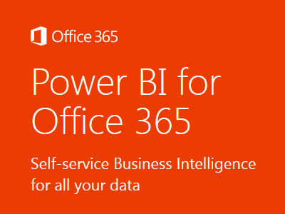

Lambda Architecture
2015 – 2016 Cohesive Story!
batch
HDInsight (Hadoop) / Data Lake
clustering
classification
stream
HDInsight (Storm) /Spark / ASA

Slide 17
Typical data workflow
storage blob
Scheduler
HDInsight (Hadoop)
Azure Web Site
Service Bus Topic / Event Hub
HDInsight (Storm)
Report User

Slide 18
Patterns in Data
Load crime data
Rank total crimes per area ordered by sum
Determine the correlation between crime, weather and economics
Load weather data
Load economics data
HDInsight (Hadoop)
MAP
REDUCE
MAP
REDUCE

Slide 19
Modern data workflow
Load crime data
Load weather data
Determine the correlation between crime, weather and economics
Correlation between crime and weather
Load economics data
REDUCE
+ ORDER BY
LINEAR REGRESSION
MAP

Slide 20
Map and Reduce physically
Map
Reduce
Input
Map
Output
Reduce
Map

Slide 21
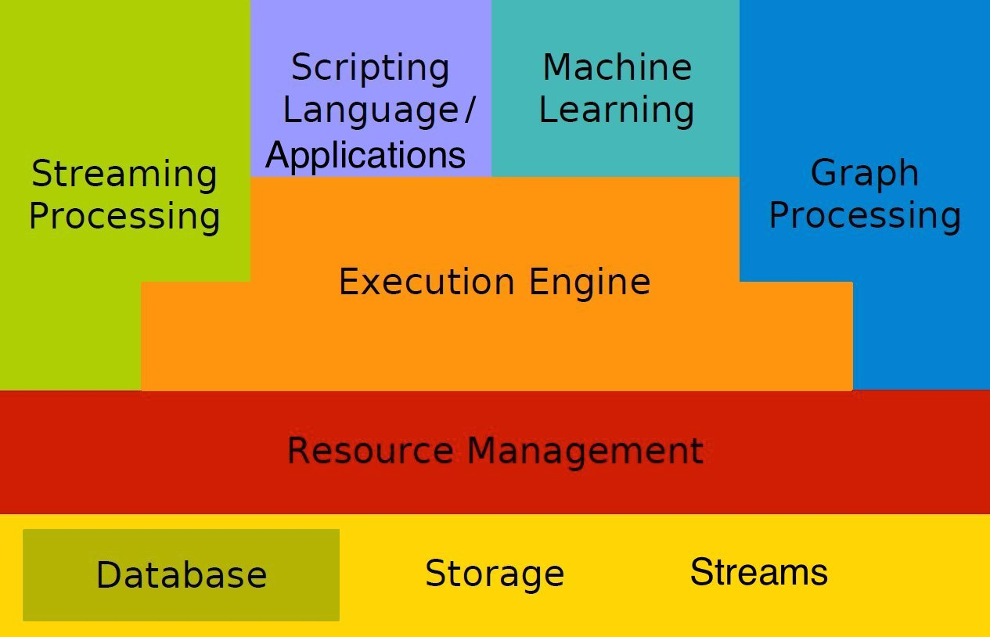
Big Data Stacks

Slide 22
Microsoft data ecosystem
Pipeline / workflow
(Oozie)
JavaScript
C#, F#, .NET
Graph
(Pegasus)
Stats processing
(RHadoop)
Machine Learning
(Mahout)
Data Integration
( ODBC / SQOOP/ REST)
Relational
(SQL Server)
Legend
Red = Core Hadoop
Blue = Data processing
Purple = Microsoft integration points and value adds
Orange = Data Movement
Green = Packages
Metadata
(HCatalog)
PDW Polybase
NoSQL Database
(HBase)
Scripting
(Pig)
Query
(Hive)
Event Driven Processing
Event Pipeline
(Flume)
Distributed Processing
(MapReduce)
Business Intelligence
(Excel, Power View, SSAS)
Distributed Storage
(HDFS)
Monitoring & Deployment (System Center)
World's Data (Azure Data Marketplace)
Azure Storage Vault (ASV)
Active Directory (Security)

Slide 23























Apache Data Ecosystem

Slide 24
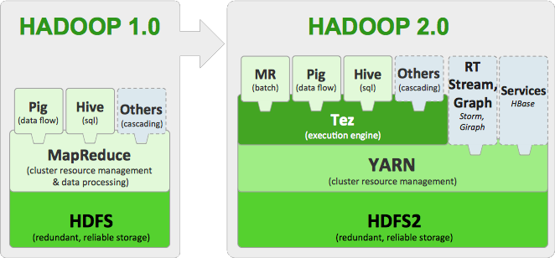
Extensibility

Slide 25




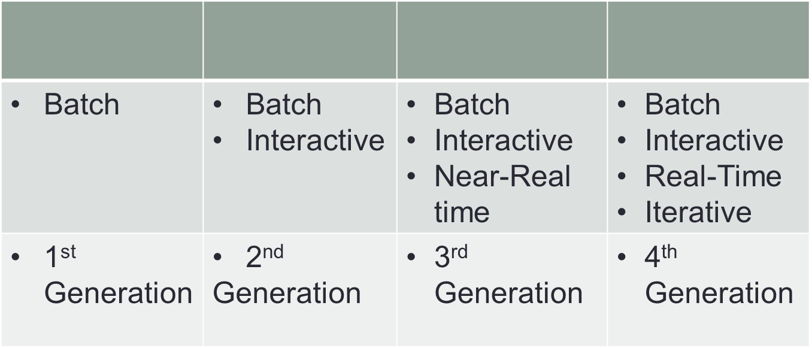
Generations of Big Data tools

Slide 26
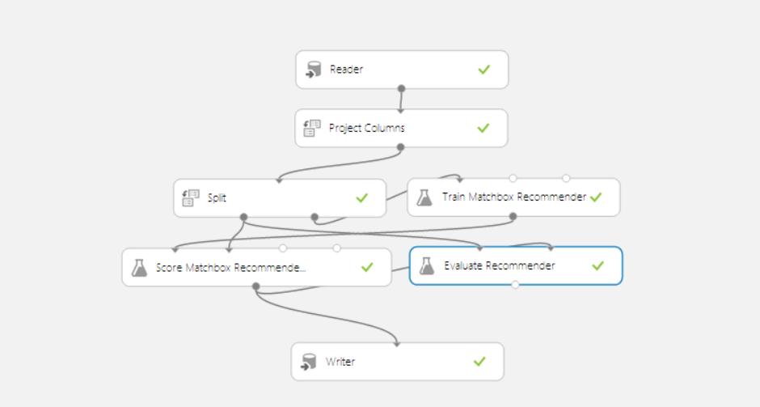
AzureML
Notes:
Slow as hell

Slide 27
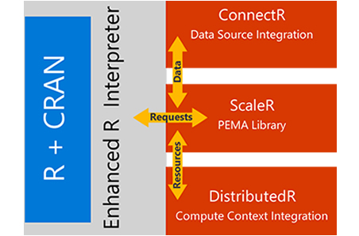
Scaling R

Slide 28
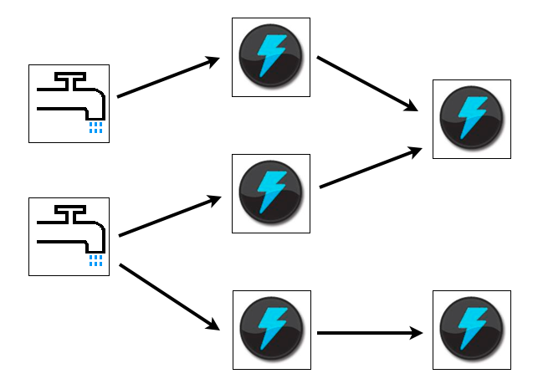
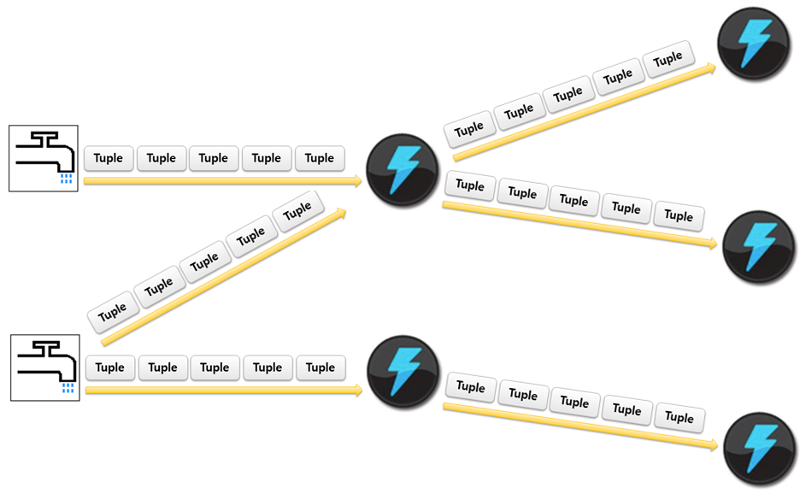
Apache Storm

Slide 29
Storm (real time)
TridentTopology topology = new TridentTopology();
TridentState wordCounts =
topology.newStream("spout1", spout)
.each(new Fields("sentence"), new Split(), new Fields("word"))
.groupBy(new Fields("word"))
.persistentAggregate(new MemoryMapState.Factory(), new Count(), new Fields("count"))
.parallelismHint(6);
public class Split extends BaseFunction {
public void execute(TridentTuple tuple, TridentCollector collector) {
String sentence = tuple.getString(0);
for(String word: sentence.split(" ")) {
collector.emit(new Values(word));
}
}
}

Slide 30
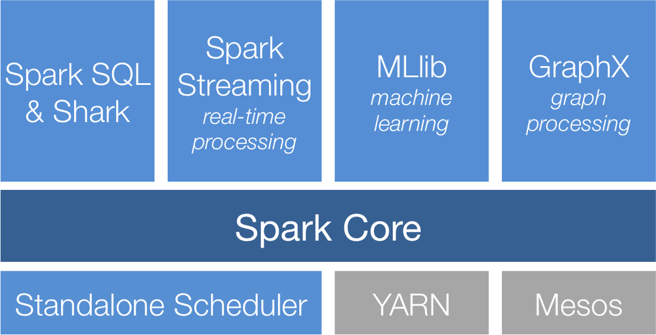
Apache Spark
Apache Spark
Standalone
YARN
Mesos
HDFS

Slide 31
Spark (micro batch)
val ssc = new StreamingContext(sc, Seconds(15))
ssc.checkpoint("./checkpoint")
val total = sc.accumulator(0, "Total")
val current = sc.accumulator(0, "Current")
val eventHubsStream = EventHubsUtils.createUnionStream(ssc, eventHubsParameters)
val mapped = eventHubsStream.map { bytes =>
val tweetLine = (new String(bytes)).split(",")
Tweets(tweetLine(0).toInt, tweetLine(1).toDouble, tweetLine(2), tweetLine(3))
}

Slide 32
Data Lake
HDInsight Service
Microsoft Revolution-R Enterprise
Other analytic solutions
SQL Data Warehouse
Data Lake
HDFS API

Slide 33


nosql
SQL Server in a VM
SQL Database
DocumentDB
Tables
Blobs
fully managed, scalable, queryable, schemafree JSON document database service for modern applications
fully featured RDBMS
transactional processing
rich query
managed as a service
elastic scale
schema-free data model
internet accessible http/rest
arbitrary data formats

Slide 34
Transforming Gaming
A story about Big Data on Azure

Slide 35





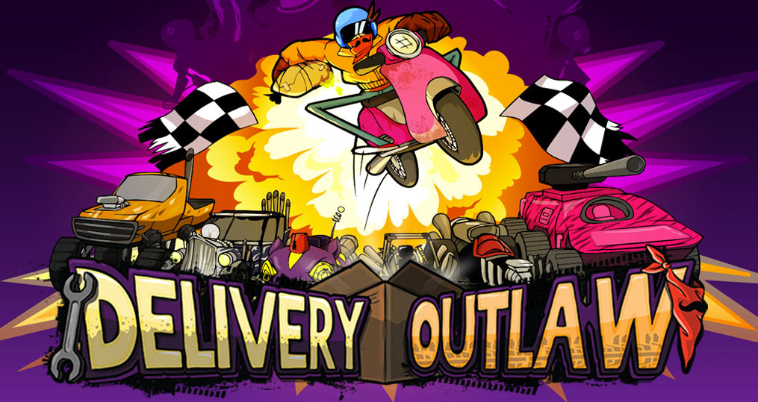

Notes:
Mediatonic are a medium-sized game studio that produce games for Disney
In 2012 Elastacloud engaged with them
Mediatonic provides an end-to-end solution for brands and media companies to make significant strategic investments in social, mobile and free-to-play games.
Mediatonic works in partnership with blue-chip companies in North America, Europe and Asia to design, develop and manage games with huge numbers of active players.
Mediatonic Games is a British independent games developer founded in September 2005^{[2]} as Mediatonic Limited. The company operates studios in London and Brighton, United Kingdom.^{[3]} The company was founded by two undergraduate students, David Bailey and Paul Croft during their final year of study at Brunel University.^{[4]} A group of industry veterans including Ian Livingstone, Kelly Sumner and Geoff Heath, invested in the company in 2010 and the company subsequently raised an undisclosed amount of Venture Capital funding from Frog Capital in January 2012.^{[5][6]}Its business model revolves around Games as a Service and digital distribution.
Mediatonic began as a digital communications agency whilst the Founders were at University; producing online marketing materials and websites for clients such asAstraZeneca.^{[8]} The company's first game was a viral flash game called Snowman Salvage released in the winter of 2005.^{[9]} The game provided a case study for Mediatonic to expand into Flash conversions for the Casual game Industry. Early games customers were businesses like PopCap, Big Fish Games and PlayFirst. In the early years, the company built casual titles in Flash such as Bejeweled and Diner Dash.^{[10]} Mediatonic expanded into creating original franchises with its partners around 2007. One of the first significant successes was Amateur Surgeon^{[11]} which, according to the Adult Swim website was played over 56 million times; making it their most played title of all time.^{[12]} The company expanded into smartphone development in 2008/2009 with the launch of its own title, Must.Eat.Birds.^{[13][14]} In 2009 the company began investing in original IPs more aggressively.^{[15]} According to its own website, the company span out its digital marketing efforts into a new business (now called Graphite Digital Ltd) so that it could focus on building games.
In 2010 the company raised funding from a group of Industry Veterans^{[16]} and began to focus on building original games (rather than converting other people's titles to different platforms).
Since 2011 the company has been working on larger titles including Foul Play for Xbox and PC,^{[17][18]} Amateur Hospital for Facebook (which received the company's first BAFTA Nomination^{[19]} and Amateur Surgeon 2 and 3,^{[20][21]} a free-to-play mobile game for iOS.
Around 2012 the company announced plans to expand with a second studio located in Brighton.

Slide 36
Games as a Service
What are they?
Notes:
What is this new as a service delivery model?
The phrase 'Games as a Service' has long since become a buzzword in games development, a term used so often it is beginning to lose meaning.
UK firm Mediatonic has just launched Games as a Service platform GameFuel, an initiative that helps indies and smaller studios harness this increasingly prolific business model. Here, Mediatonic CEO David Bailey offers more insight as to what 'Games as a Service' really involves, how studios can benefit from it, and how previous developers have abused it.
When I think about Games as a Service, I think about games that deploy a web-based infrastructure so that they can be continuously updated. Developers use this to react to audience behaviours and deliver events and features that nurture long-term engagement.
It’s a response to a consumer shift that has impacted not only the games industry but entertainment in general. The internet encourages people to graze on content and to access media through lots of devices, in the same way consumers are gravitating towards platforms like Netflix and Spotify.
The world’s biggest tech companies are racing towards an Internet of Things. This means we can expect many more devices to emerge for entertainment and the cloud will be the common element that connects them all. As a result, Games as a Service has become a critical operating model for modern games companies.
But developers and publishers often underestimate how differently an organisation needs to act in order to deliver a successful service. The biggest problem I encounter day-to-day is muscle-memory within these organisations. Video Games have been shipped as products for decades and many decision makers and influencers have deeply ingrained behaviours from this experience.
The hardest piece of this is puzzle is in aligning teams with the philosophy of being data-driven, fast, customer-centric, and avoiding building “one person’s folly”.
Traditionally video games companies have been organised to ensure that hundreds of engineers and artists can build out the artistic vision of a handful of mangers. This can be a tough approach to change after decades of shipping boxed-products.

Slide 37
Games as a Service means that, as a developer, the power to extend the life of your game is in your own hands, not the publisher's
Dave Bailey, CEO, Mediatonic Games
Notes:
Games as a Service democratises games for developers gives

Slide 38
Why Mediatonic needed Cloud Game Analytics
The reality of the situation is that you’ll never see a penny from the vast majority of your players
Only 2.2% of active free-to-play gamers ever purchase content in app
Half of all in-app revenue contributed by 0.15% of players
2/3 players will never play again within 24 hours
Notes:
From 1 million players we are left with approximately 335,000 players.
Let’s call these your active players.
Among this number, 7,370 are likely to make some sort of purchase and a mere 500 will make a significant enough contribution to add up to 50% of your app’s revenue.
That’s 500 high-value customers out of 1,000,000 installs.
Moral of the story: You need a lot of players before you can start seeing any revenue.

Slide 39

Know your player
Notes:
What is it about people and why they play games?
Some games companies understand their demographic very well now – take King – the makers of Candy Crush – they define themselves as an analytics company – they understand their demographic better than anyone
Same with the company Zynga – who employed a large number of data scientists to crunch numbers because they understood that their revenue was all about understanding their demographic
The typical solution to problems of scale is to throw money at the problem. Invest a few grand in app install ads and watch your customer-base grow. As long as customers contribute more than they cost, you’re doing something right.
Except the mobile gaming category doesn’t work like this. It costs $2.73 to acquire a customer and the average active player contributes only $1.96 per month.
Of course, this isn’t a problem if players remain engaged for at least six weeks… but only 10% of customers do.

Slide 40



Testing success
Notes:
Mediatonic were able to test every single change
Why is this important? Each region reacts differently to each other region so introducing changes in the game may make engagement and monetisation worse as well as better
Every few hours they received a report letting them know whether the change was good or bad
This enabled them to plan their next steps to determine whether changes were good and should permeate through the game/games
This is also another use of knowing your player – in order to do this we have to collect large amounts of data on our player such as
Where they are from
Have they paid already
How active are they within the game
With this we can also test a random segment called a bucket which can tell us what sort of popularity we can expect for an introduction of a change into the game like this

Slide 41




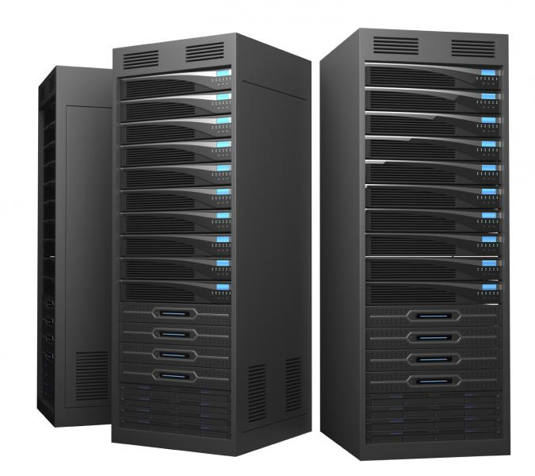
Being Agile
Notes:
Adding more games to the system can be done in days – then you have a complete overall intelligence of new games without the headache of more development – the cloud scalability and ability to provide resources on demand
In the past Mediatonic had to provision more servers in Amazon and apply software on these servers – increase the scale of the RedShift service
In Azure the entire process is automatic – they don’t need any intervention – Azure automatically scales to the number of games they add to the system without fear of slowing down or invalidating their reporting process

Slide 42
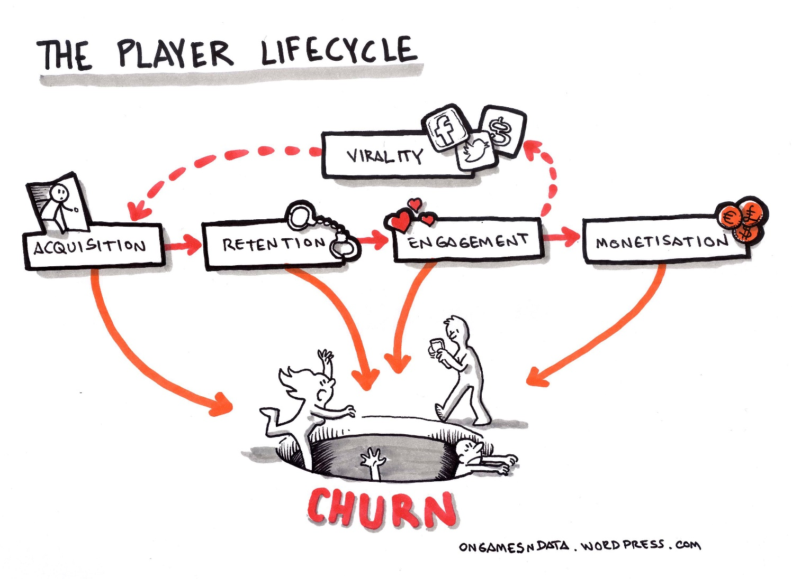
Predicting the Future with Retention and Churn
Notes:
- Get players playing faster.
- Get players in the game ASAP.
- the closer to the game’s launch that players first sign on, the longer they’re likely to be retained.
- On average, 6.2% of the players who first signed in within one month of a game’s initial launchsigned in again 360 days later.
In contrast, only 0.63% of players who signed in one year after the games initial launch logged on again 360 days later.
This year we have looked at pro-actively using Azure Machine Learning to keep players engaged for longer – and the longer players engage the more the game revenue increases. Since this has been in place we have evidence to show an increase in over 2% of engagement (early days so not sure yet) – this has been done by predicting the churn of the players using machine learning – if we predict that the session that players play will be there last one we can send them an offer email to keep them engaged with the game for longer to avoid losing them.

Slide 43
The Analytics Stack
Notes:
1. Event Hub data is sent from the collector as single JSON encoded messages
2. Worker role(s) write to an AppendBlob and roll over every hour. A transformation is done on the hour from Append Blob -> Block Blob
3. Hourly trigger will cause Azure Data Factory to read in the Blob timeslice
4. Data Factory will use a small existing HDInsight cluster or a larger new cluster with a set of PIG Scripts and a custom UDF and aggregate the message feed to manageable hourly data to include sessions, player behavior and reports.
5. Azure SQL DB Premium will hold the collected data and PowerBI will be used to display the results using a custom dashboard

Slide 44
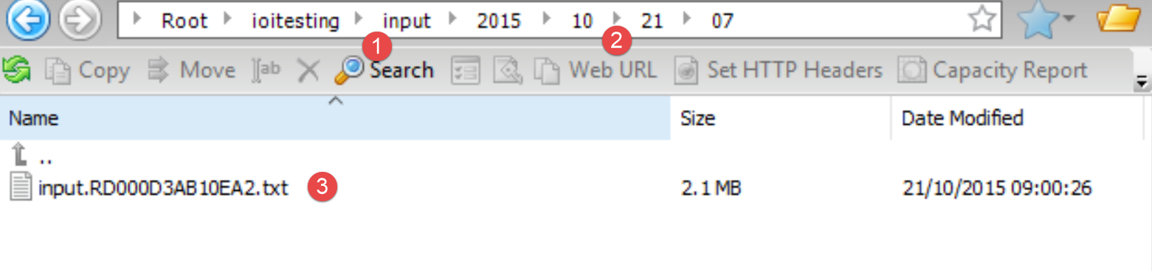
Worker Roles: Persisting JSON
Notes:
Events are read from the eventhub using a worker role written in c#.
The worker role constantly reads from the eventhub and places the data in an append blob in storage.
At current test workloads the size of the blob is 4MB/hour.
Every hour on the hour that append blob is copied over to another location into blob storage as a block blob and a new append blob is created.
The root location of the block blob is configurable from within the worker role and the path is further decided based on the current date and time.
These blob files hold the raw event for the previous hour in a json format with one line per event.
Append Blobs are problematic but are being introduced into all systems currently
These files are then processed every hour at ten past the hour by Azure Data Factory.

Slide 45
Worker Role: Filtering Data
Notes:
- Data has lots of issues so here we clean it up before processing
We have built a simple filters interface
This is currently built and compiled in a worker role assembly
If this is needed future improvements could be to add Dependency Injection and dynamically load filters – in all probability the filters should be made redundant over time as the JSON data is cleaned up at source or within the collector
Current filters include removing new line characters, invalid characters, transforming some JSON and adding somethings

Slide 46
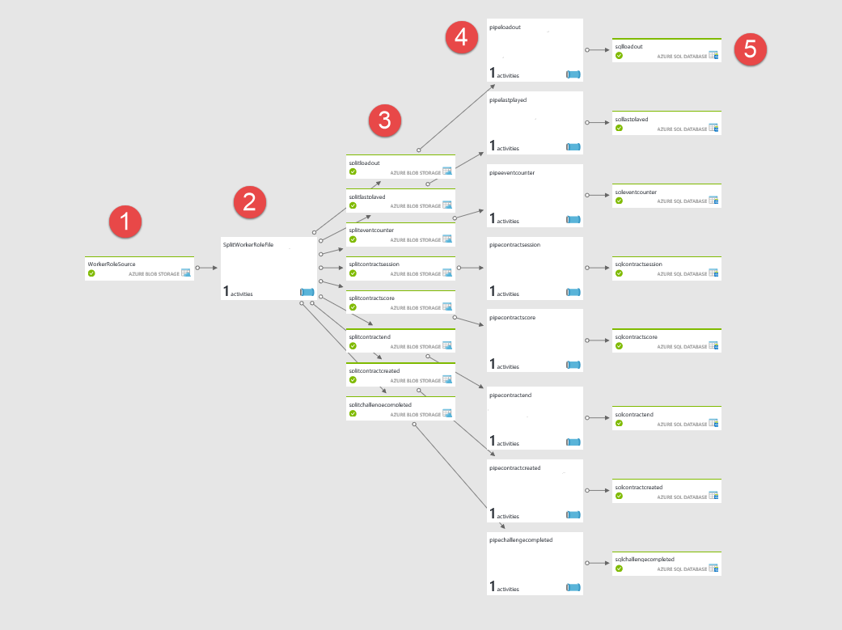
Azure Data Factory
Notes:
Source file generated by the worker role every hour
HDInsight/Pig process
Output of Pig process in Blob Storage
Pipelines that process the results of #3 and call stored procedures in Azure SQL Server
Destination tables in Azure SQL Server

Slide 47
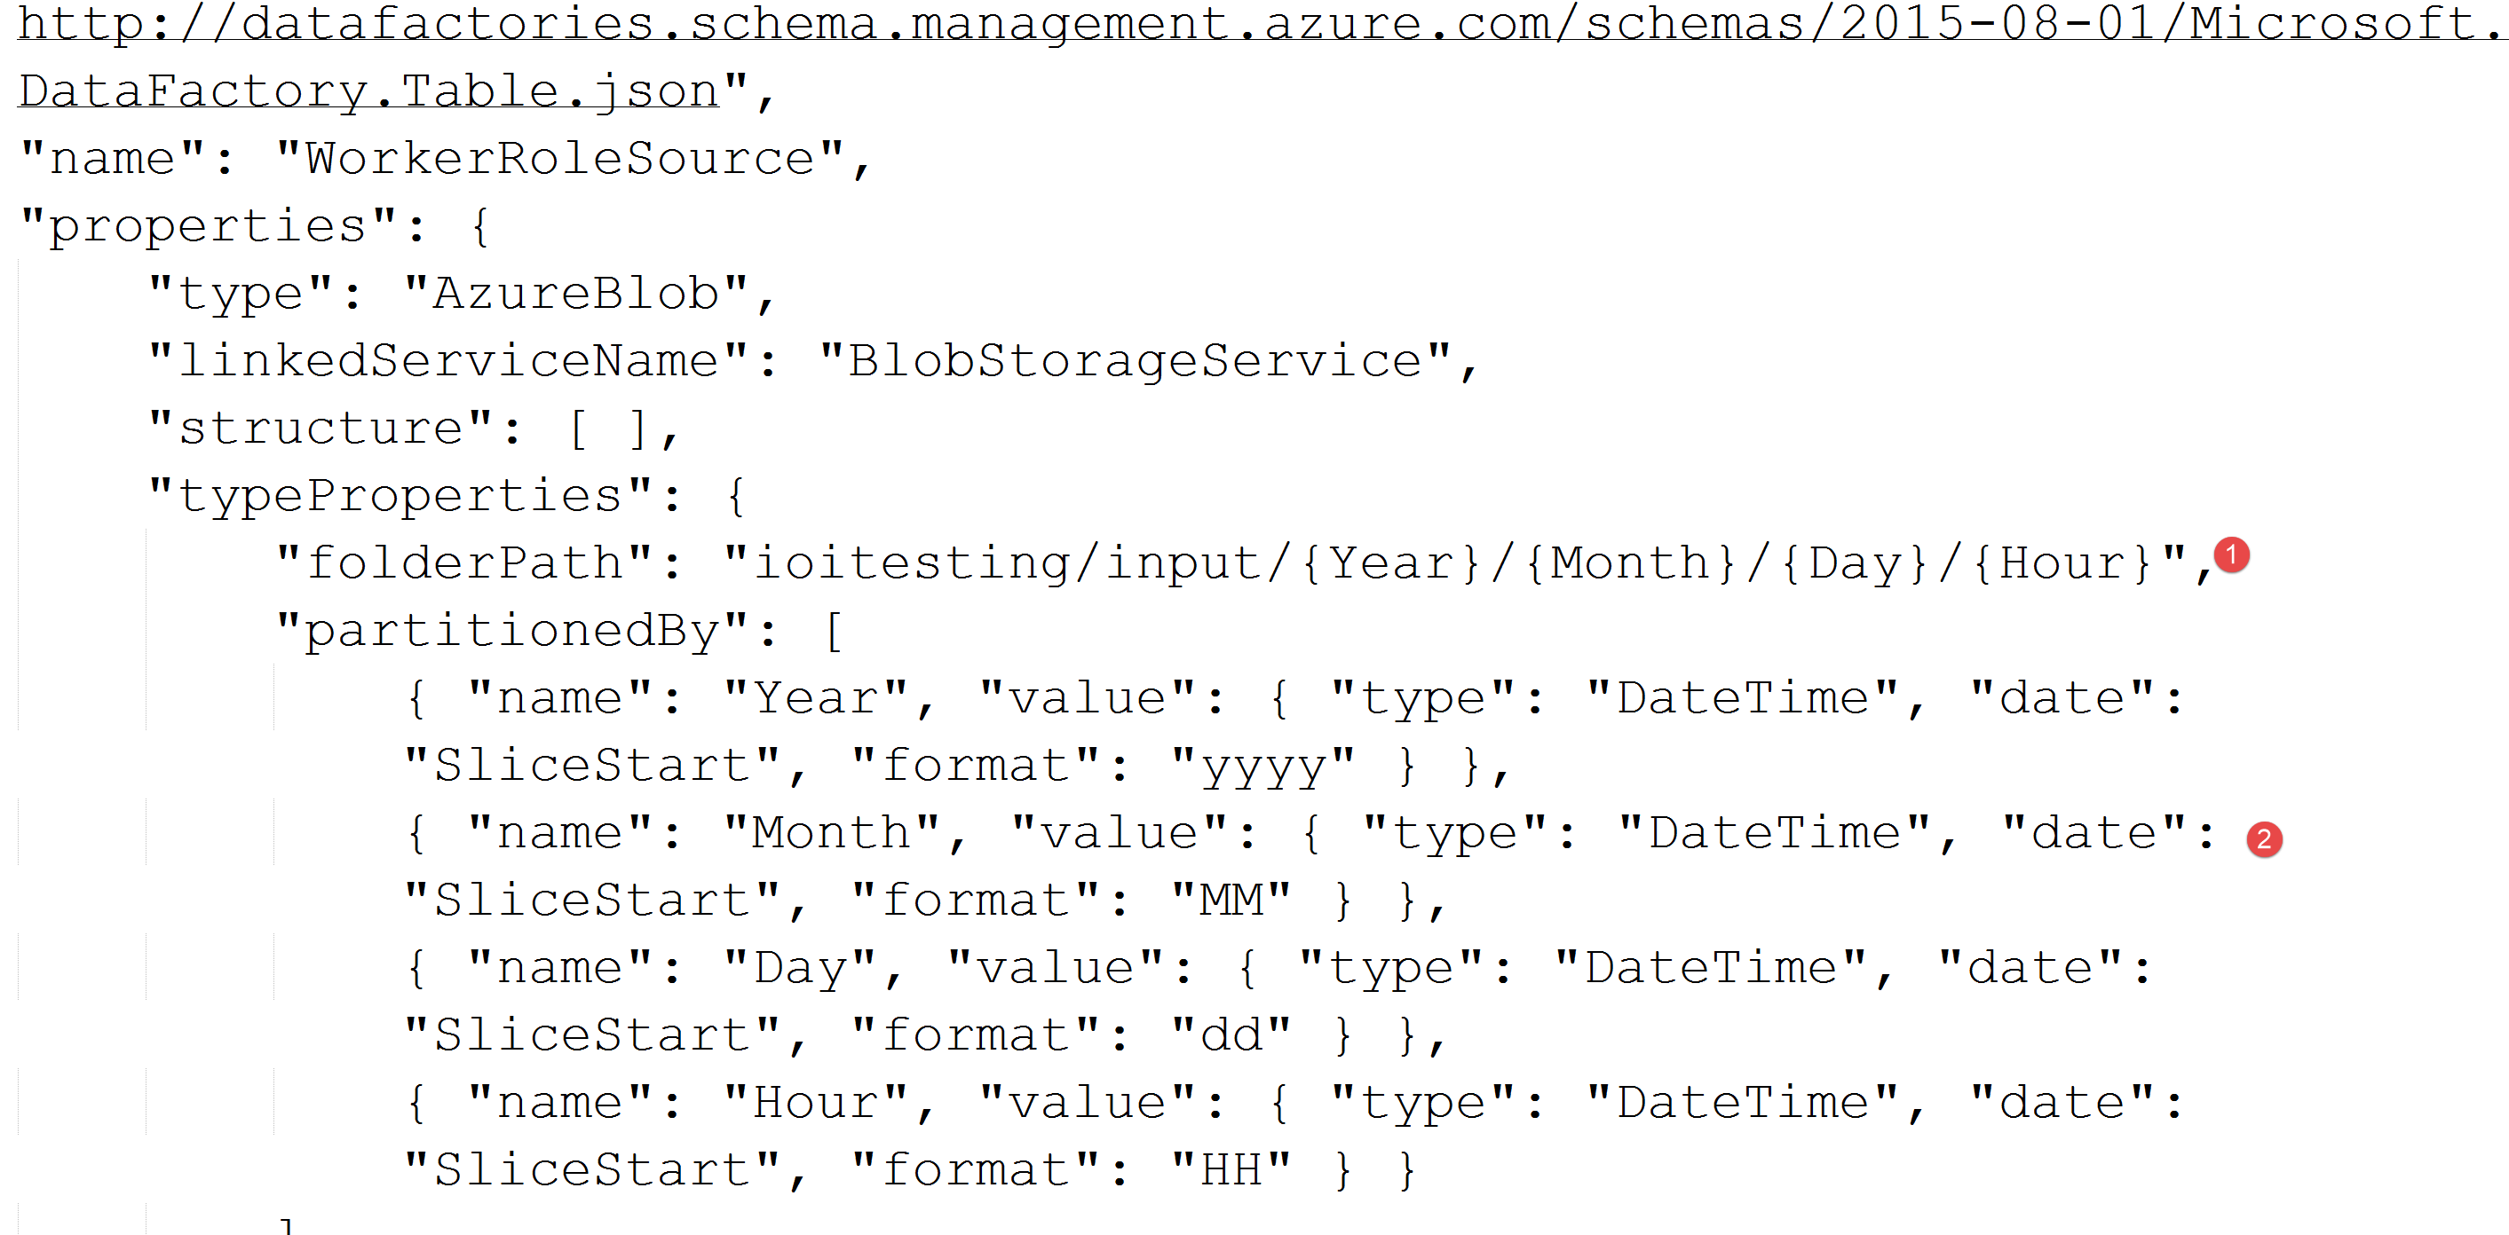
1. Getting the time slice from storage
Notes:
1. Path to the location of the file with parameters
2. Parameter value assignments based on when this time slice is being run.

Slide 48
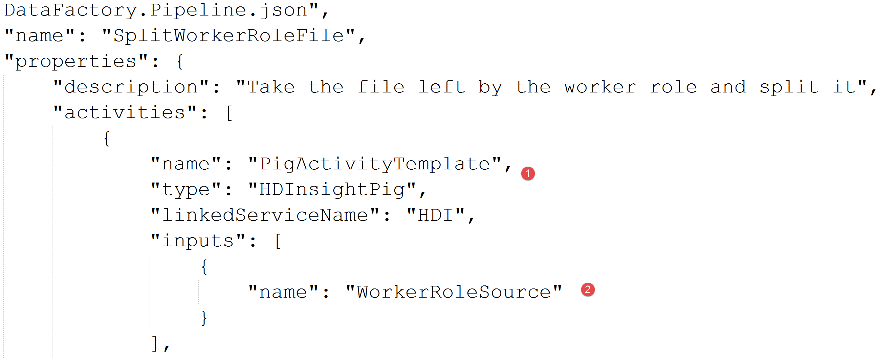
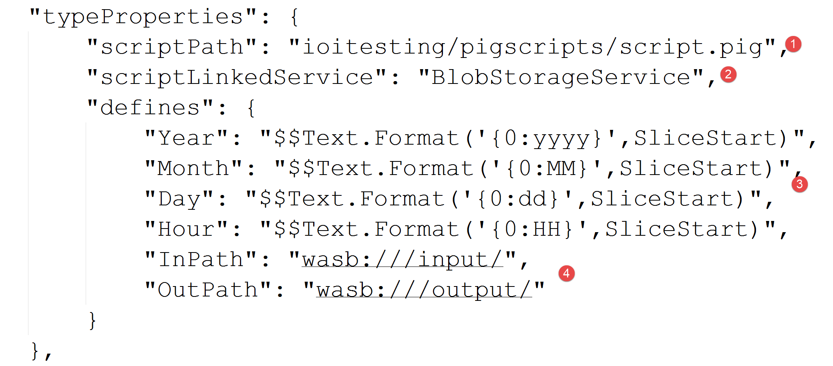
2. Bootstrapping a PIG Job on HDI
Notes:
Script 1:
1. The type of pipeline we are about to run
2. The file we are passing in.
Script 2:
1. The location of the pig script to run
2. The storage account for the pig script
3. Temporal parameters for our pig script
4. Location parameters for our pig script

Slide 49
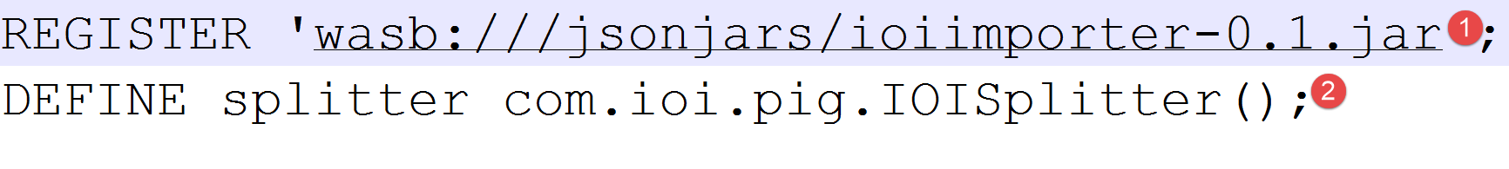
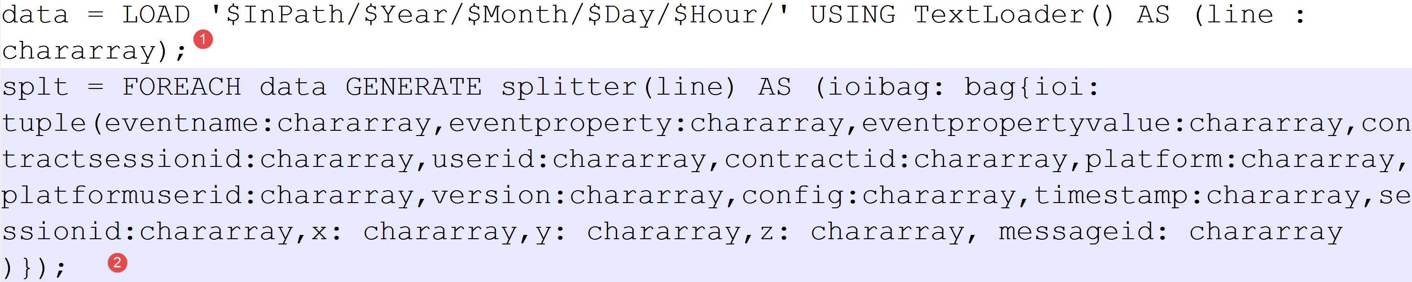
PIG on HDInsight
Notes:
Script 1:
1. Where to find the jar file for the custom EvalFunc()
2. Define the method we will call.
Script 2:
1. Using parameters passed in to the script we load the source file
2. We then pass in the loaded data to our custom routine.

Slide 50
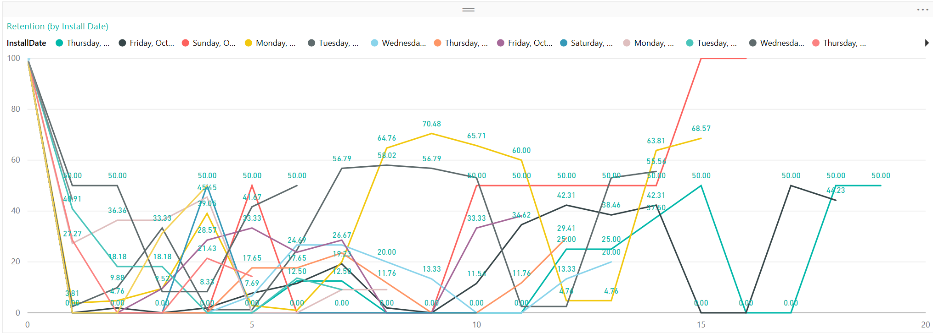
Building a PowerBI Dashboard
Notes:
PowerBI recap – mapping onto the views in PowerBI and looking at PowerBI desktop and evolving queries for the desktop
Explain calculated columns and metrics
REST API – fully functional now can push events directly in a timeline without the use of ASA – explain bisharp

Slide 51
Phase 2: Using Apache Spark
Notes:
Explain the history of the Spark project and how it is evolved and who is using it –
Different ways of clustering etc. and what HDI does to cut down the configuration

Slide 52
RDDs
messages = sc.textFile(...).filter(_.startsWith(“ERROR”))
.map(_.split(‘\t’)(2))
HDFS File
Filtered RDD
Mapped RDD
filter (func = _.contains(...))
map (func = _.split(...))
Notes:
Why Phase 2 – follow the Microsoft strategy – Spark now 1.5.2 and includes remote execution
Explain RDDs, Spark clustering and services
- python, scala and Java

Slide 53
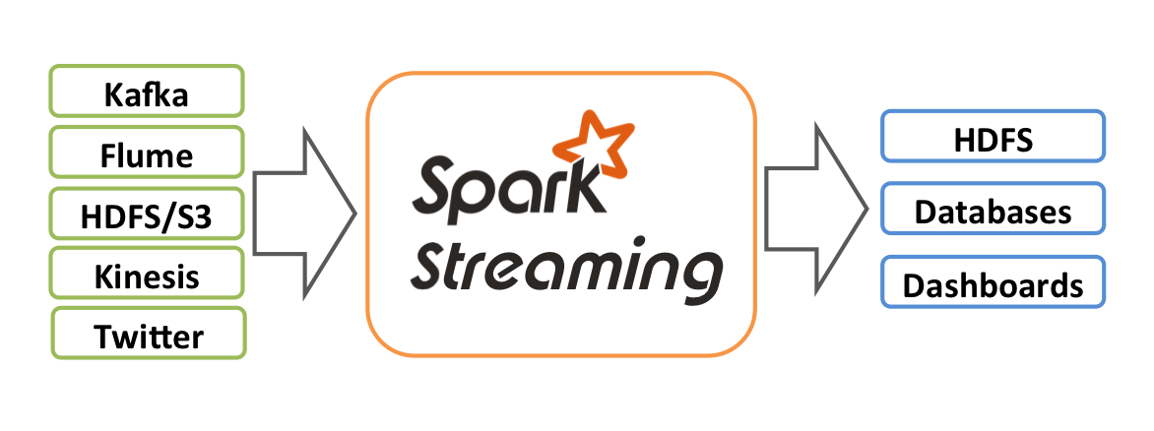
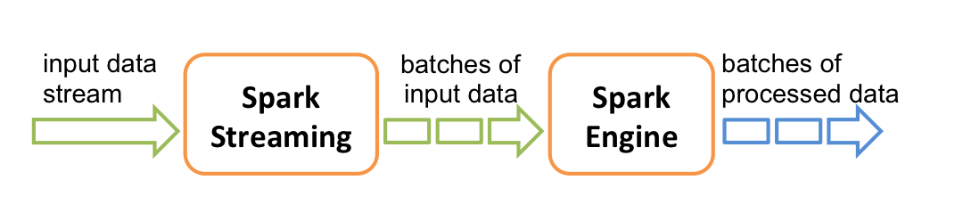
Spark Streaming

Slide 54
Spark SQL
val lines = sc.textFile("/cluster/events.json")
val people = sqlContext.jsonFile(lines)
people.registerAsTable(“events")
val teenagers = sqlContext.sql("SELECT * FROM events WHERE Name = ‘InstanceActivated’")
Notes:
Explain Spark SQL and what you can do with it – some of the UpdateKey patterns (being able to update and store values in key-value form so that you can have rolling updates in memory) and being able to interrogate historical data and real-time SQL data

Slide 55
Thank you!
Any Questions?

